Slide 1

FAKE NEWS AND IMAGE DETECTION USING TEXT -ANALYSIS AND AI GENERATED IMAGE IDENTIFICATION
TEAM MEMBERS:
R.HARSHA VARDHANI,Y22ACM467 P.RAVI,Y22ACM465
P.SAI VENKATA RAJESH,Y22ACM462
GUIDED BY: B.KISHOR BABU
ASSISTANT PROFESSOR
Dept of AIML

Slide 2
ABSTRACT
The rapid spread of misinformation through digital news and social media, often supported by manipulated or AI-generated images, has become a major challenge. This project presents a multimodal fake news detection system that analyzes both text and images to improve accuracy and reliability. The text module uses BERT,GRU,CNN for classification, while the image module applies deep learning models such as ResNet and EfficientNet to detect manipulated content. Unlike traditional methods, the system provides separate predictions for text and image, helping identify the source of misinformation and enhancing transparency, accuracy, and reliability in fake news detection.

Slide 3
SCOPE OF THE PROJECT
Detecting fake news articles using text analysis techniques.
Identifying AI-generated or fake images associated with news content.
Detecting morphed or manipulated images used with real or fake news.
Classifying the following scenarios:
Real News with Real Images
Fake News with Real Images
Real News with Fake / AI-Generated Images
Fake News with Fake Images
Providing separate results for text and image authenticity to improve transparency.
Helping users understand whether misinformation originates from text, image, or both.
This project is applicable to social media platforms, news agencies, fact-checking systems, and digital forensics.

Slide 4
EXISTING SYSTEM
The existing system is used to detect fake news available on the internet.
It mainly analyzes the text content of news articles and posts.
Natural Language Processing (NLP) techniques are applied to understand the text.
Machine learning and deep learning algorithms are trained on real and fake news datasets.
The system checks keywords, sentence structure, and writing patterns.
Some systems also consider basic image features along with text.
Text and image data are usually processed together.
A single output is generated to classify news as real or fake.
These systems help reduce the spread of misleading information online.
Existing systems are commonly used in news portals and social media platforms.

Slide 5
LIMITATIONS OF EXISTING SYSTEM
Unimodal Architecture – Primarily text-focused; ignores cross-modal inconsistencies between text and images.
Limited Image Forensics – Uses shallow or basic image features; fails to detect AI-generated artifacts and manipulation patterns.
Shallow Context Modeling – Traditional ML models cannot capture long-range semantic dependencies or subtle linguistic deception.
Black-Box Output – Produces a single combined prediction without identifying whether misinformation originates from text or image.
Low Interpretability – No independent confidence scores; difficult to justify decisions.
Moderate Accuracy – Performance degrades on multimodal or AI-generated content.
Poor Scalability – Not optimized for handling heterogeneous real-world social media data.
Limited Practical Applicability – Cannot support digital forensics or fine-grained misinformation source analysis.

Slide 6
PROPOSED SYSTEM
The proposed system detects fake news using both text and image analysis.
It uses Natural Language Processing (NLP) techniques to analyze news text.
Deep learning models are applied to classify news as real or fake.
The system also analyzes images to detect AI-generated, fake, or manipulated images.
Text and image are processed through separate modules.
The system provides independent results for text and image authenticity.
Users can give only text, only image, or both as input.
The system identifies whether misinformation comes from text, image, or both.
It improves accuracy and reliability compared to existing systems.
The proposed system is suitable for social media, news platforms, and fact-checking systems.

Slide 7
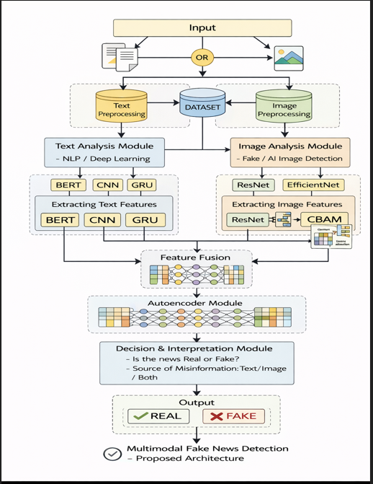
SYSTEM ARCHITECTURE:

Slide 9
DESIGN
The system is developed using a multimodal deep learning approach that combines both text and image analysis to detect fake news.
Data Collection & Preprocessing:
A multimodal dataset consisting of news text and related images and datasets is collected.
Text data is preprocessed by removing noise, converting to lowercase, and tokenization.
Image data is preprocessed through resizing, normalization, and optional augmentation.
2. Text Analysis Module:
The input text is processed using BERT to extract contextual embeddings.
These embeddings are passed through a CNN layer to capture local patterns and important phrases.
A GRU layer is then used to learn sequential dependencies in the text.
Finally, a text authenticity score is generated.

Slide 10
Image Analysis Module:
The input image is processed using deep learning models like ResNet or EfficientNet to extract high-level visual features.
An attention mechanism (CBAM) is applied to focus on important regions of the image.
This module generates an image authenticity score.
Decision & Fusion Module:
The outputs from both text and image modules are combined using a late fusion technique.
The system also identifies the source of misinformation as text-based, image-based, or both.
Final Output:
The system produces the final prediction as Fake or Real news along with a confidence score, improving interpretability and reliability.

Slide 11
IMPLEMENTATION OF CODE
The project is implemented using Python with deep learning frameworks and a modular structure.
Text Model Implementation:
The text classification model is built using BERT, CNN, and GRU.
BERT is used for contextual embeddings, CNN extracts local features, and GRU captures sequential dependencies.
The Text model train with ISOT ,Fakenews net datsets
The trained model is saved as text_model.pth.
Image Model Implementation:
The image classification model uses ResNet / EfficientNet with CBAM attention mechanism.
It extracts deep visual features and detects AI-generated or manipulated images.
The Image model trained with deepfake,ai generated,morphed image datasets.
The trained model is saved as image_model.pth.

Slide 12
Model Integration:
Both models are loaded using separate modules (text_model.py and image_model.py) and used for prediction.
Threshold Calibration:
A calibration script (calibrate_threshold.py) is used to optimize decision thresholds and improve accuracy.
Main Application:
A user interface is developed using Streamlit (main.py) to accept text and image inputs and display results.
Execution Process:
Install dependencies, run calibration, and launch the application using

Slide 13
RESULTS
Developed a Multimodal Fake News Detection System combining:
Text Model (BERT + CNN + GRU)
Image Model (RESNET+EFFICIENT NET+CBAM)
Performance:
Text Model Accuracy: ~85–95%
Image Model Accuracy: ~80–90%
Threshold Optimization:
Applied calibration (calibrate_threshold.py)
Improved confidence & reduced false positives
System Output (Streamlit App):
Predicts REAL / FAKE
Displays confidence score (%)
Supports both text & image input
Model Dectects
Fake vs Real News (Text)→ Identifies misleading or genuine news content
Images→ Detects:AI-generated images,Deepfakes,Morphed images

Slide 14
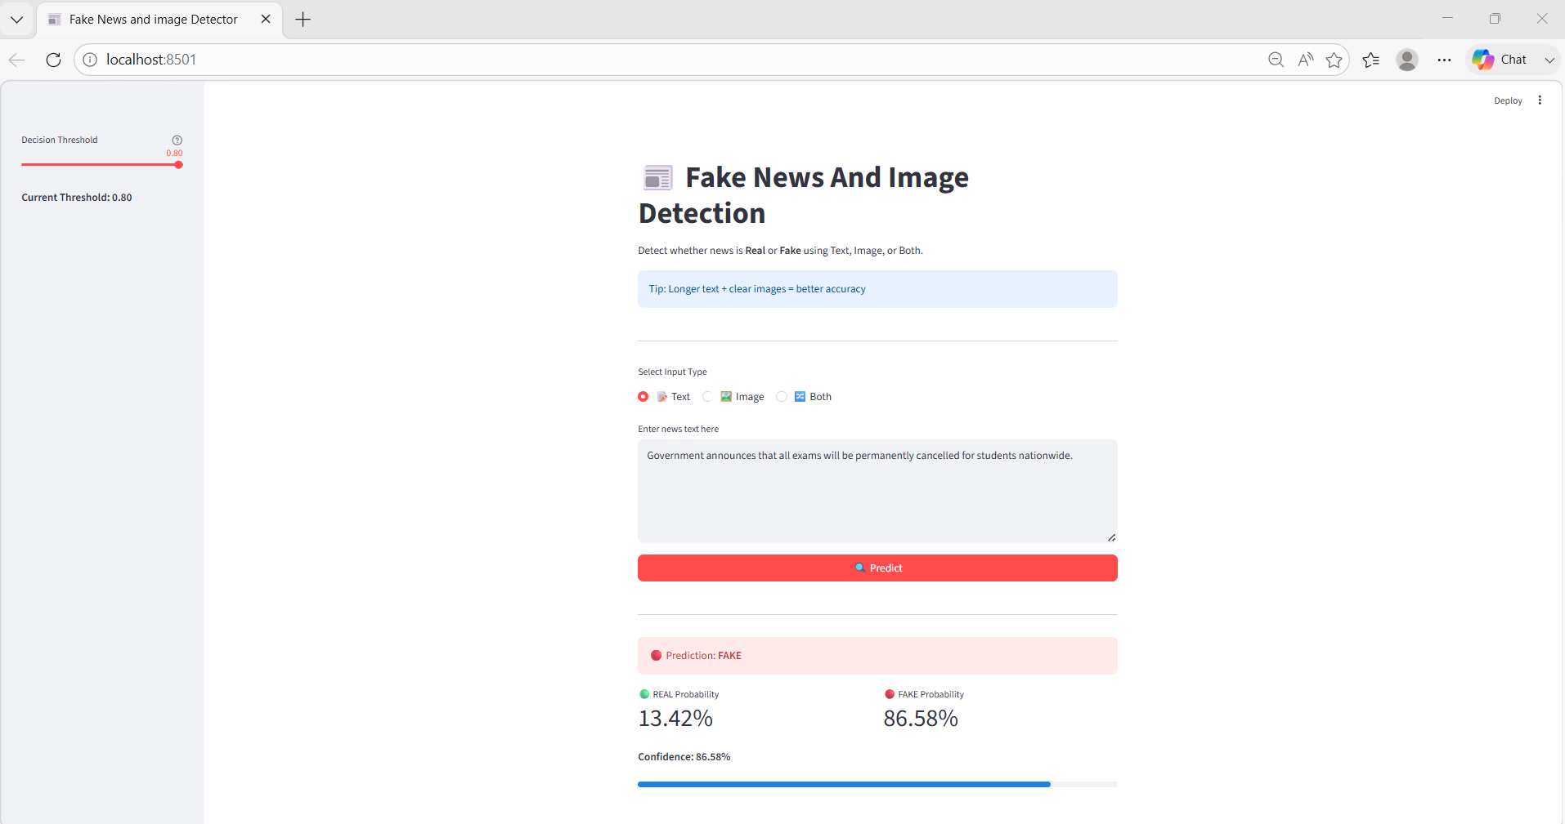
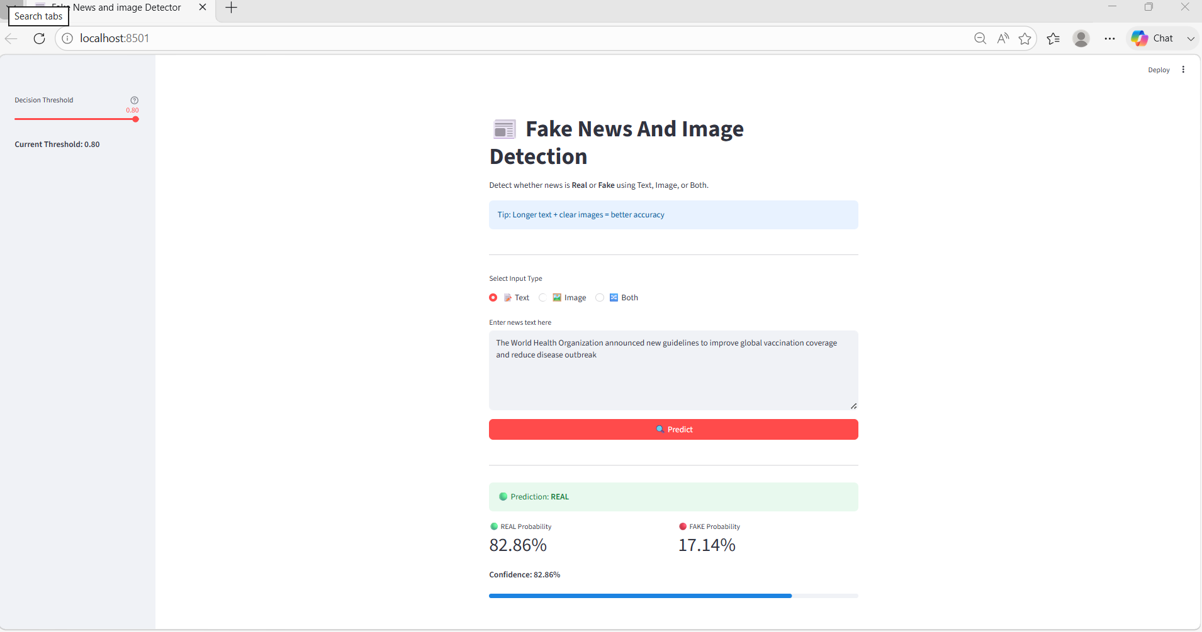
OUTPUT SCREEN TEXT PREDICTION

Slide 15
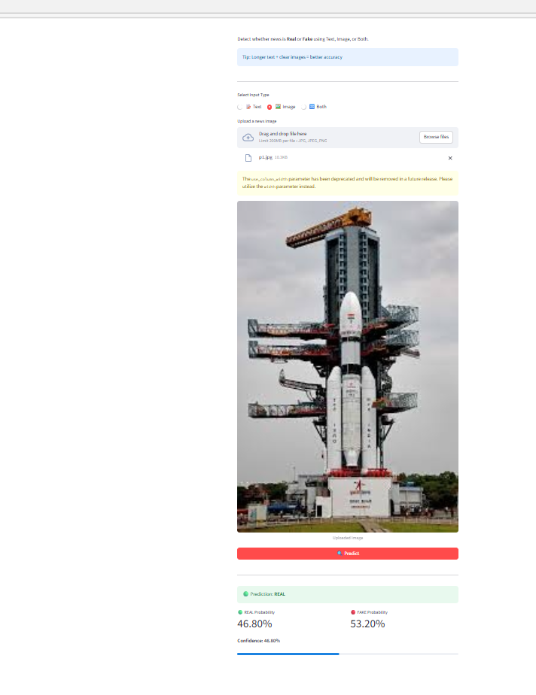
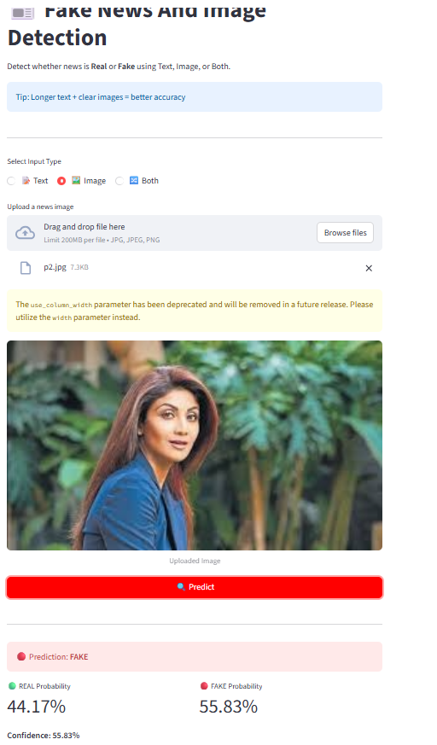
I IMAGE PREDECTION

Slide 16
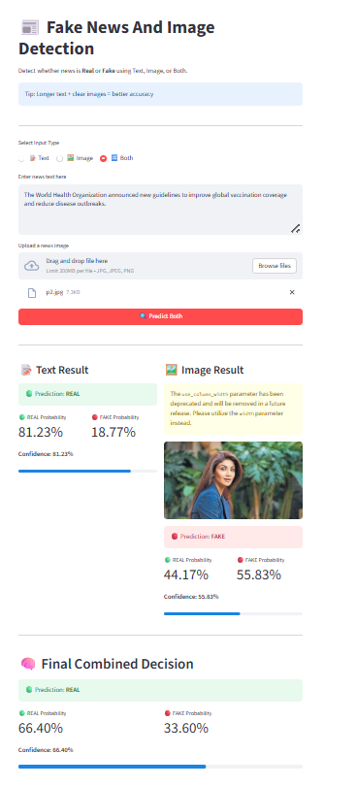
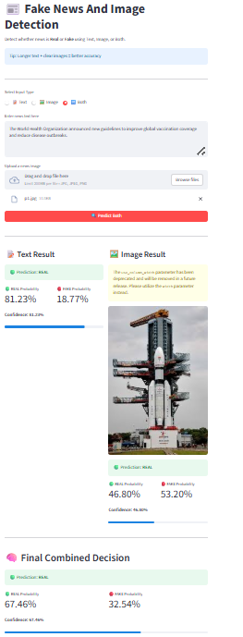
BOTH TEXT AND IMAGE PREDICTION

Slide 17
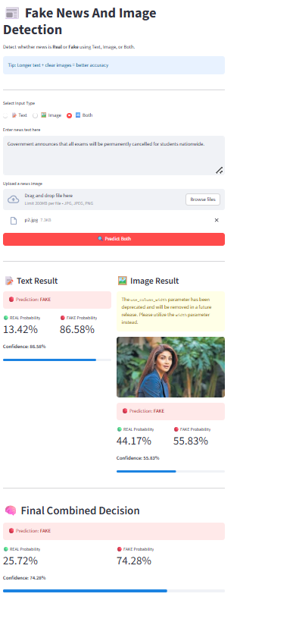
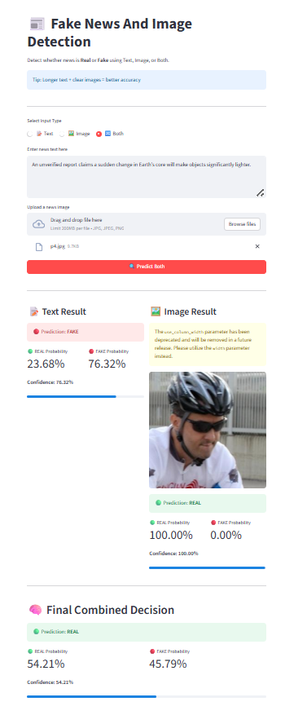

Slide 18
CONCLUSION
This project presents a multimodal fake news detection system that analyzes both text and images to identify misinformation. By using advanced AI models for text understanding and image analysis, the system can accurately detect fake news content. It provides separate results for text and images, making the output more clear and transparent. Compared to traditional systems that focus only on text, this approach improves accuracy, reliability, and interpretability. The proposed system can be effectively used for social media monitoring, fact-checking, and digital news verification in real-world applications.

Slide 19
REFERENCE
Ahmed Hashim Jawad Almarashy et al., “Elevating Fake News Detection Through Deep Neural Networks, Encoding Fused Multi-Modal Features”,IEEE Access, 2024.
Jin et al., “Multimodal Fusion with Recurrent Neural Networks for Rumor Detection”,ACM Multimedia, 2017.
Nakamura et al., “FAKEDDIT: A Multimodal Benchmark Dataset for Fake News Detection”,2019.
Devlin et al., “BERT: Pre-training of Deep Bidirectional Transformers for Language Understanding”,2018.
He et al., “Deep Residual Learning for Image Recognition”,CVPR, 2016.

Slide 20
ANY QUERIES?

Slide 21
THANK YOU!

